Slide 1
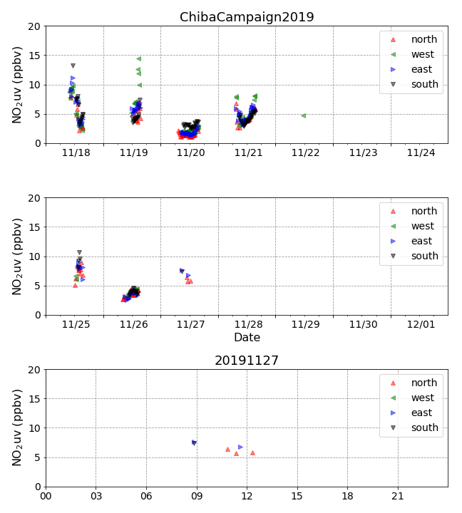
NO₂ time series

Slide 2
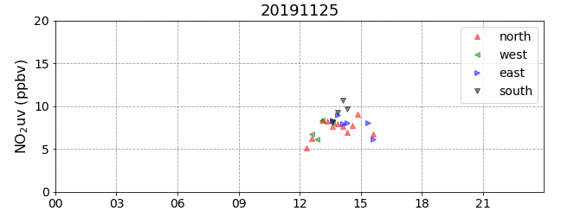
NO₂ time series
hour

Slide 3
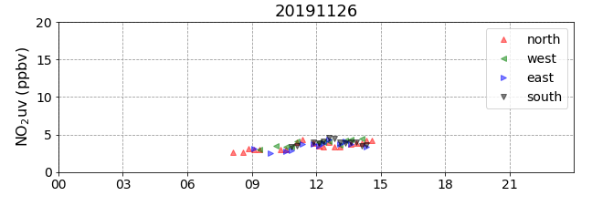
NO₂ time series
hour

Slide 4
NO₂ time series
hour

Slide 5
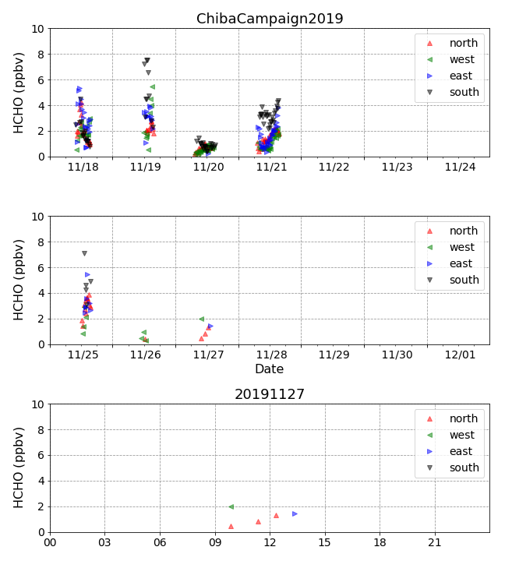
HCHO time series

Slide 6
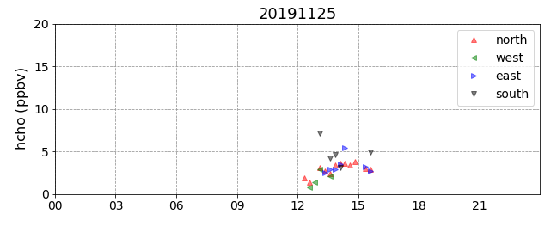
HCHO time series
hour

Slide 7
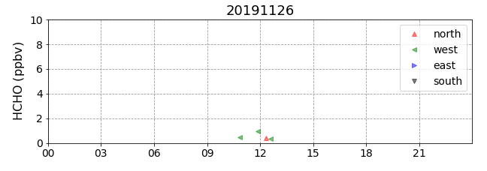
HCHO time series
hour

Slide 8
HCHO time series
hour

